Slide 1
REAL-WORLD APPLICATIONS OF STACK & QUEUE
Presented by : Praveen
Faculty Advisor : Dr. Victor Govindaswamy

Slide 2
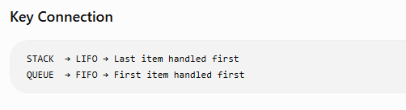
REAL-WORLD APPLICATIONS OF STACK & QUEUE
Stack Applications
1. Undo / Redo
Applications store recent actions in a stack.
The most recent action is removed first when we use Undo.
This follows LIFO — Last In, First Out.
2. Browser Navigation
Recently visited pages can be tracked using stack behavior.
The most recently visited page can be returned to first.
Queue Applications
1. Print Queue
Documents wait for a printer in order.
The first document submitted is normally printed first.
This follows FIFO — First In, First Out.
2. Customer Service
Customers can be served in the order they arrive.
The first customer waiting is handled first.

Slide 3
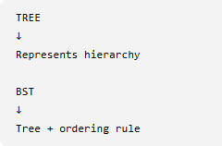
TREE & BST APPLICATIONS
Tree Applications
1. File Systems
Folders can contain subfolders.
Subfolders can contain more folders and files.
A tree naturally represents this hierarchy.
2. Organizational Hierarchies
A company can be represented with managers and employees.
One manager can have multiple employees below them.
3. HTML/XML Structure
Web pages and XML documents have nested elements.
Parent and child relationships naturally form a tree.
BST Applications
1. Searching Ordered Information
A BST organizes values using the left-smaller/right-larger rule.
This structure can support searching through ordered data.
2. Maintaining Sorted Data
Values are organized according to their relationships.
Inorder traversal produces the values in sorted order.
Main Difference

Slide 4
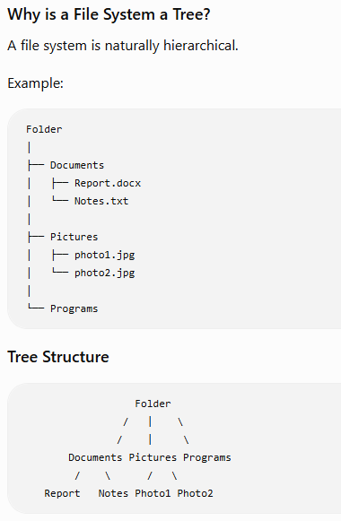
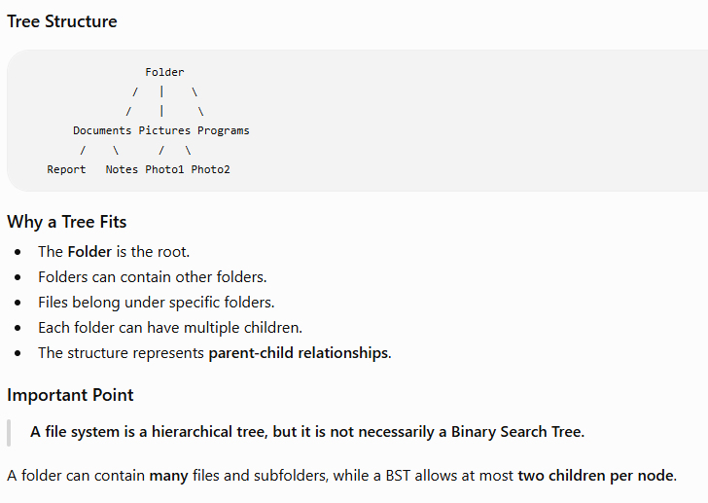
FILE SYSTEM AS A TREE

Slide 5
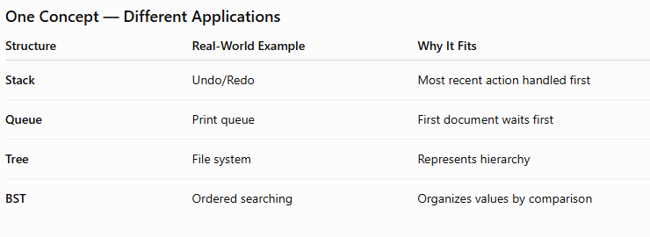
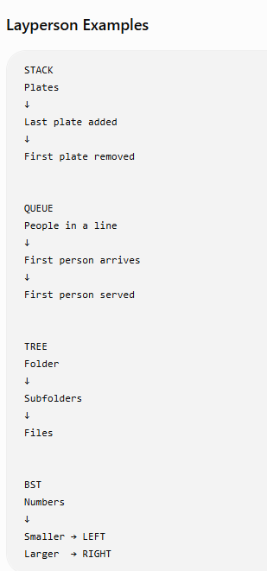
CONNECTING THE DATA STRUCTURES TO REAL LIFE

